Slide 1
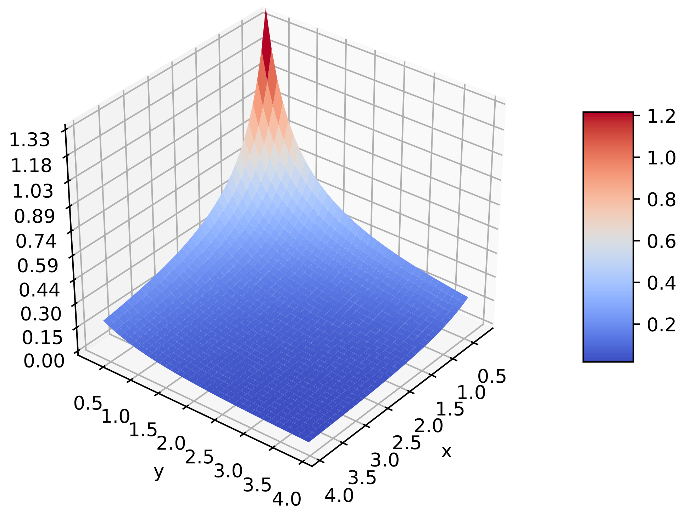
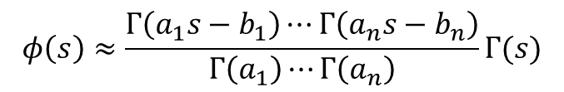
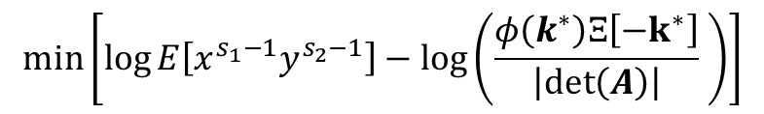
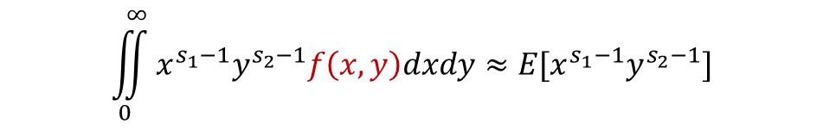

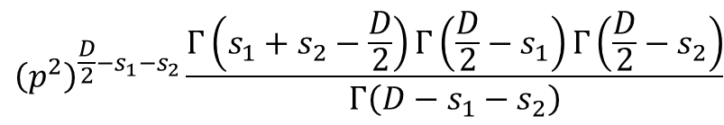
Numeric Data
Estimate Fingerprint (moments)
$$\iint_{0}^{∞}{x^{s_{1}−1}y^{s_{2}−1}f\left(x,y\right)dxdy≈E[x^{s_{1}−1}y^{s_{2}−1}]}$$
Multivariate Mellin Transform
Assume a Fingerprint (Mellin-Barnes Integral)
$$φ\left(s\right)≈\frac{Γ\left(a_{1}s−b_{1}\right)⋯Γ\left(a_{n}s−b_{n}\right)}{Γ\left(a_{1}\right)⋯Γ\left(a_{n}\right)}Γ(s)$$
Not clear how to fit
$$\min\left[\log{E\left[x^{s_{1}−1}y^{s_{2}−1}\right]}−\log\left(\frac{φ\left(k^{∗}\right)Ξ\left[−k^{∗}\right]}{\left|\det\left(A\right)\right|} \right)\right]$$
Fit Data to Fingerprint ‘Machine Learning’
$$f\left(x,y\right)=\frac{e^{−\frac{xy}{x+y}p^{2}}}{{\left(x+y\right)}^{D/2}}$$
Inverse Mellin Transform By exploitation of GMRT
$${\left(p^{2}\right)}^{\frac{D}{2}−s_{1}−s_{2}}\frac{Γ\left(s_{1}+s_{2}−\frac{D}{2}\right)Γ\left(\frac{D}{2}−s_{1}\right)Γ\left(\frac{D}{2}−s_{2}\right)}{Γ\left(D−s_{1}−s_{2}\right)}$$
Solved Fingerprint
Function/Solution

Slide 2
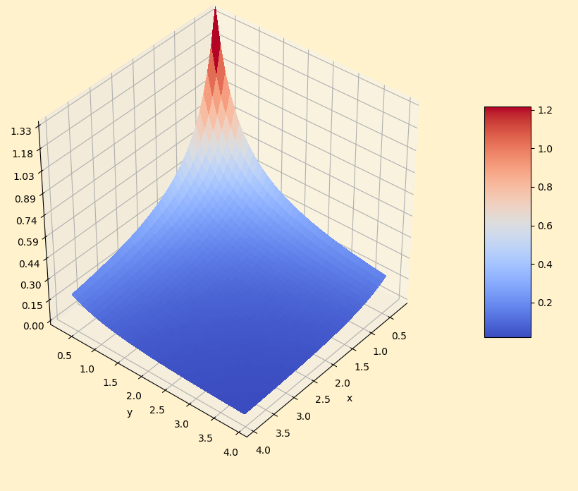

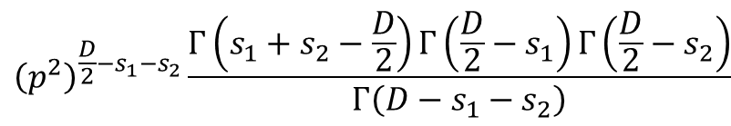
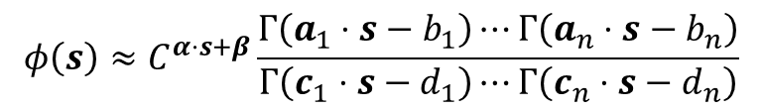
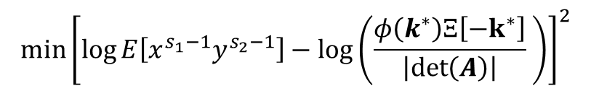
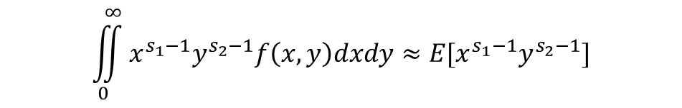
$$\iint_{0}^{∞}{x^{s_{1}−1}y^{s_{2}−1}f\left(x,y\right)dxdy≈E[x^{s_{1}−1}y^{s_{2}−1}]}$$
Estimate Fingerprint (Moments)
Multivariate Mellin Transform
Numeric Data
$$φ\left(s\right)≈C^{α⋅s+β}\frac{Γ\left(a_{1}⋅s−b_{1}\right)⋯Γ\left(a_{n}⋅s−b_{n}\right)}{Γ\left(c_{1}⋅s−d_{1}\right)⋯Γ\left(c_{n}⋅s−d_{n}\right)}$$
Assume a Fingerprint (Mellin-Barnes Integral)
Not clear how to fit
?
$$\min{{\left[\log{E\left[x^{s_{1}−1}y^{s_{2}−1}\right]}−\log\left(\frac{φ\left(k^{∗}\right)Ξ\left[−k^{∗}\right]}{\left|\det\left(A\right)\right|} \right)\right]}^{2}}$$
Fit Data to Fingerprint ‘Machine Learning’
$$f\left(x,y\right)=\frac{e^{−\frac{xy}{x+y}p^{2}}}{{\left(x+y\right)}^{D/2}}$$
Inverse Mellin Transform By exploitation of GMRT
$${\left(p^{2}\right)}^{\frac{D}{2}−s_{1}−s_{2}}\frac{Γ\left(s_{1}+s_{2}−\frac{D}{2}\right)Γ\left(\frac{D}{2}−s_{1}\right)Γ\left(\frac{D}{2}−s_{2}\right)}{Γ\left(D−s_{1}−s_{2}\right)}$$
Function (Solution)
Solved Fingerprint

